Slide 1

Grace Evangelical Society
Annual Conference
May 20-23, 2019
PLENARY SESSION 7
“Spiritual Gifts: The Ultimate WHY”
Ephesians 4:7-16
Steve Thurman
GRACE EVANGELICAL SOCIETY
National Conference 2019

Slide 2


Slide 3
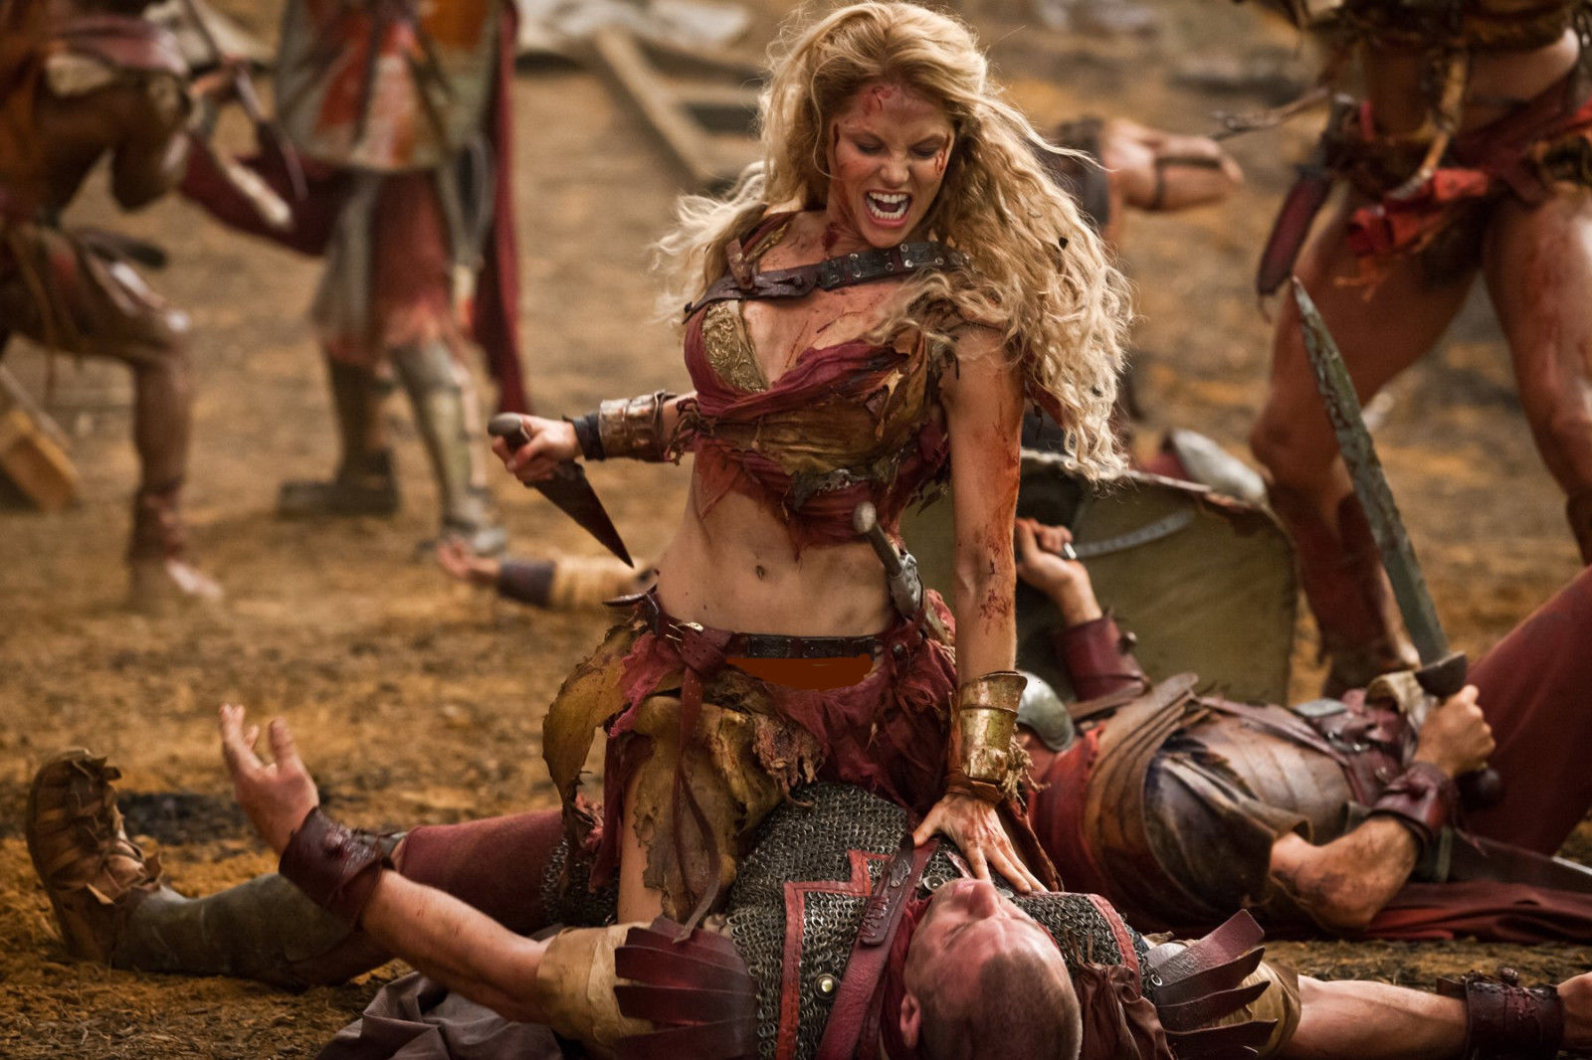

Slide 4


Slide 5
Ephesians 4:7-16
SPIRITUAL GIFTS
A source of joy, purpose, service … and confusion
Knowing what my spiritual gift(s) are NOT is as important as knowing what my spiritual gifts actually are.

Slide 6
Ephesians 4:7-16
But to each one of us grace was given according to the measure of Christ’s gift. Therefore He says: ‘When He ascended on high, He led captivity captive, and He gave gifts to men.’ (Now this, ‘He ascended’ – what does it mean but that He also first descended into the lower parts of the earth? He who descended is also the One who ascended far above all the heavens, that He might fill all things.) And He Himself gave some to be apostles, some prophets, some evangelists, and some pastors and teachers, for the equipping of the saints for the work of ministry, for the edifying of the body of Christ, till we all come to the unity of the faith and of the knowledge of the Son of God, to a perfect man, to the measure of the stature of the fullness of Christ; that we should no longer be children, tossed to and fro and carried about with every wind of doctrine, by the trickery of men, in the cunning craftiness of deceitful plotting, but, speaking the truth in love, may grow up in all things into Him who is the head—Christ—from whom the whole body, joined and knit together by what every joint supplies, according to the effective working by which every part does its share, causes growth of the body for the edifying of itself in love.

Slide 7
Ephesians 4:7-16
Areas of Disagreement
#1 – the interpretation of verse 8
Therefore He says: ‘When He ascended on high, He led captivity captive, and gave gifts to men.’

Slide 8
Ephesians 4:7-16
Areas of Disagreement
#2 – the interpretation of verse 9
Now this, ‘He ascended’– what does it mean but that He also first descended into the lower parts of the earth?

Slide 9
Ephesians 4:7-16
Areas of Disagreement
#3 – The Definitions of (almost all) specific spiritual gifts
Definitions are often vague, lacking clarity
Some definitions by cessationists leave us with continuationist options
Some definitions are frustrating at best, damaging at worst

Slide 10
Verse 11
My Opinion
And He Himself gave some to be apostles, some prophets, some evangelists, and some pastors and teachers …
There are no prophets today, and there is no prophecy today
There are no apostles today, in terms of the uniqueness of The Twelve + Paul
Evangelists and pastor-teachers continue to this day

Slide 11
Ephesians 4:7-16
Areas of General Agreement
A. Definition of “spiritual gift”
  B. Purpose (v 12)
  C. End Results .. or Targets (v 13)
  D. as Protection (vss 14-16)

Slide 12
WHY spiritual gifts?
TO HONOR and PLEASE the LORD ..
BY .. USING OUR SPIRITUAL GIFTS ..
TO .. SERVE ONE ANOTHER ..
IN .. a FERVENT SPIRIT of LOVE
Though I speak with the tongues of men and of angels, but have not love, I have become sounding brass or a clanging cymbal. And though I have the gift of prophecy, and understand all mysteries and all knowledge, and though I have all faith, so that I could remove mountains, but have not love, I am nothing. And though I bestow all my goods to feed the poor, and though I give my body to be burned but have not love, it profits me nothing.
I Cor 13:1-3

Slide 13
Spiritual Gifts
The Emphasis on Love
Ephesians 4 the phrase “in love” occurs 3 x (vss 2, 15, 16)
I Peter 4:8 “above all things, have fervent love for one another”
Rom 12:6-8 7 spiritual gifts are in the context of:
12:1-2 – the call to __________________________________
12:3 – the call to ___________________________________
12:4-8 – the call to _________________________________
12:9-21 – the call to _________________________________

Slide 14
APPLICATION
What do I make of all this?
Love is, and is to be, the way of life for us
Humble servant-love is to characterize the exercise of all spiritual gifts

Slide 15
What is love?
(think of a mother’s love)
LOVE IS .. AFFECTION .. CORRECTION .. and SACRIFICE …
ALL WITH A PURPOSE:
to HELP SOMEONE GROW to MATURITY (in Christ)
to HELP SOMEONE GO from .. DEPENDENCE (on mom)
to .. DEPENDENCE on GOD

Slide 16
Grace Evangelical Society
Annual Conference
May 20-23, 2019
PLENARY SESSION 7
“Spiritual Gifts: The Ultimate WHY”
Ephesians 4:7-16
Steve Thurman

Slide 17
The Gift of Apostleship has Ceased
1. they were personally chosen by God for this (apostolic) ministry
Paul says he “was called to be an apostle of Jesus Christ through the will of God” (1 Cor 1:1)
they were chosen by God and appointed by Jesus Christ
“You did not choose Me, but I chose you and appointed you …” (John 15:16)
they were required to have personally seen (and accompanied) Jesus Christ
“From the baptism of Jesus .. to the day He was taken from us .. witness to resurrection” (Acts 1:21-22)
they had a unique relationship with Jesus and unique ministry responsibilities
“He appointed twelve that they might be with Him, that He might send them out to preach
and to have power to heal sicknesses and to cast out demons” (Mark 3:14-15)
the church is “built on the foundation of the apostles and prophets, Christ Jesus being the chief cornerstone” (Eph 2:20)
they were promised special places of honor in the future
“Now the wall of the city [the New Jerusalem] had twelve foundations, and on them were the names of
the twelve apostles of the Lamb” (Rev 21:14)
Special Note: “if our brethren are inquired about, they are messengers [apostoloi] of the churches …” (2 Cor 8:23)

Slide 18
Grace Evangelical Society
Annual Conference
May 20-23, 2019
PLENARY SESSION 7
“Spiritual Gifts: The Ultimate WHY”
Ephesians 4:7-16
Steve Thurman

