Slide 1

Paul’s Hallelujah Chorus:
Ephesians 1:1-14
John H. Niemelä
GRACE EVANGELICAL SOCIETY
National Conference 2019

Slide 2
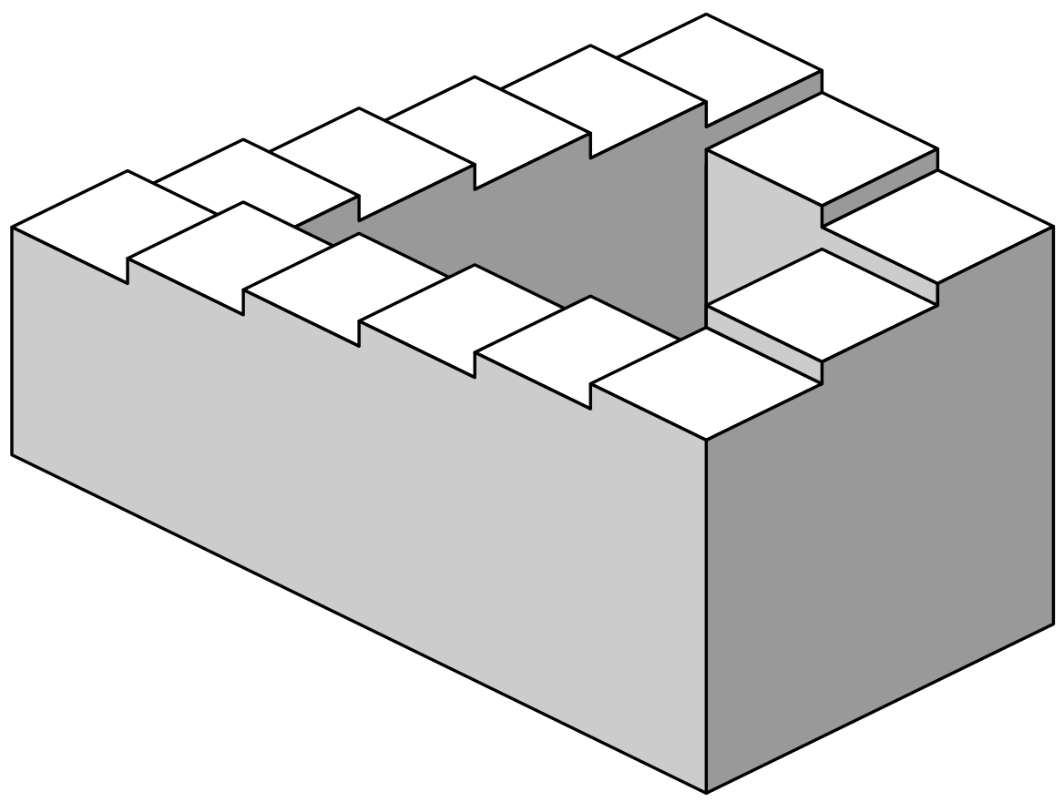
Penrose stairs
Start

Slide 3
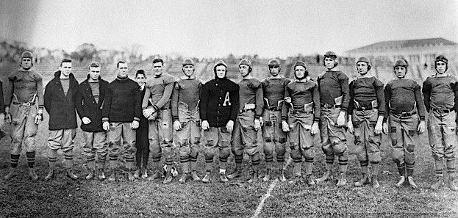
Dwight D. Eisenhower at West Point

Slide 4
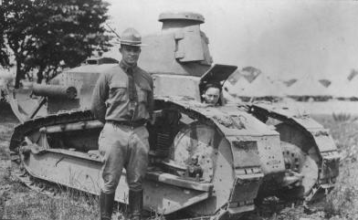
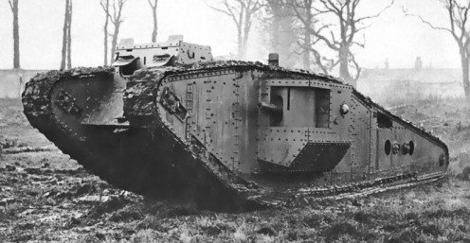
French Renault tank for training at Camp Colt
What the U.S. Army actually used in combat

Slide 5
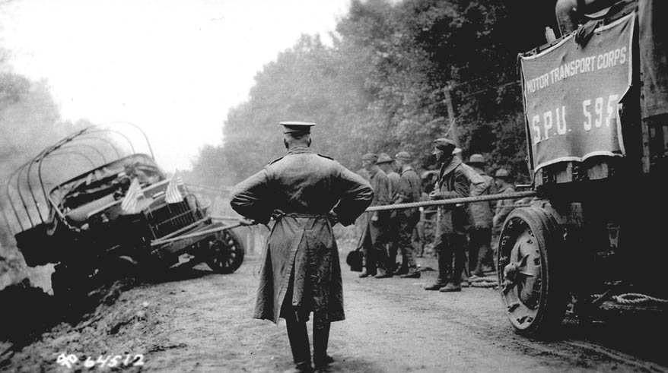
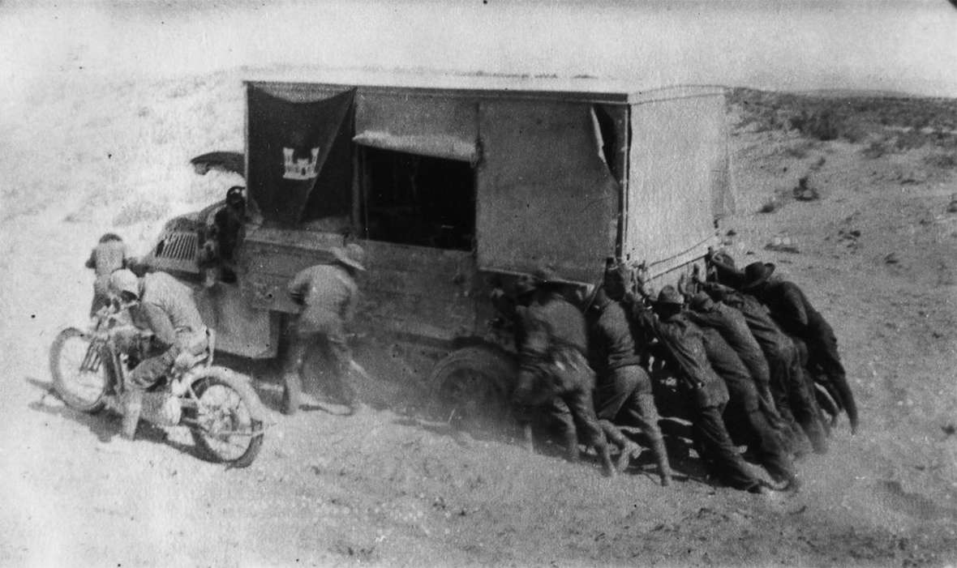
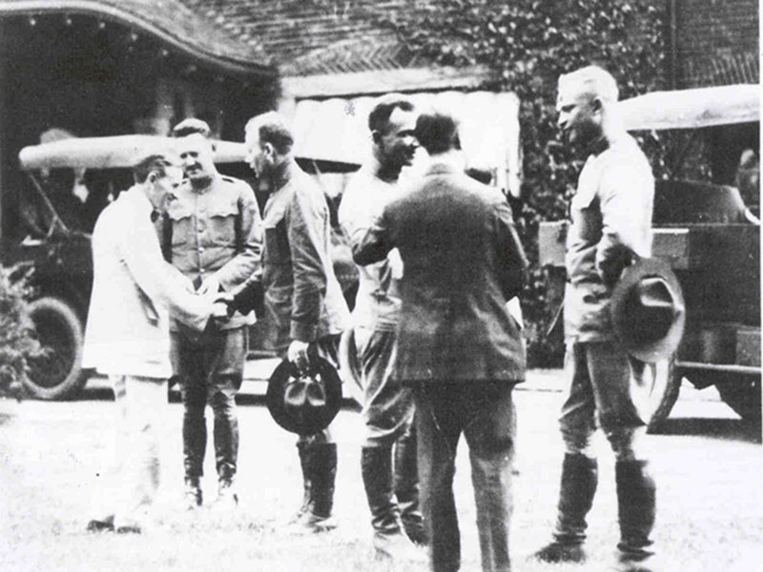
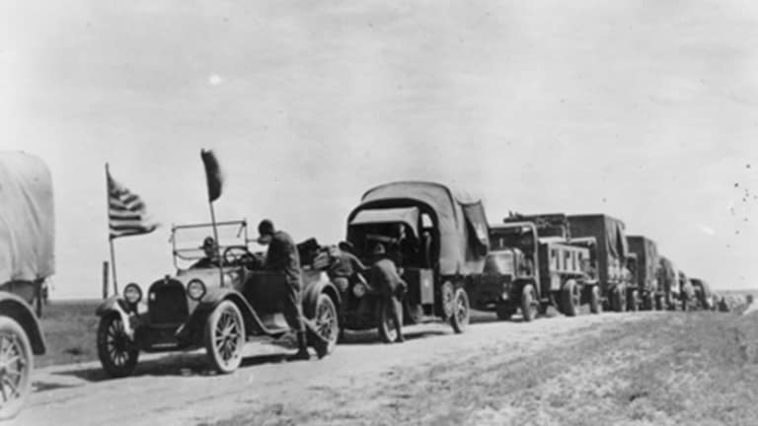

Slide 6
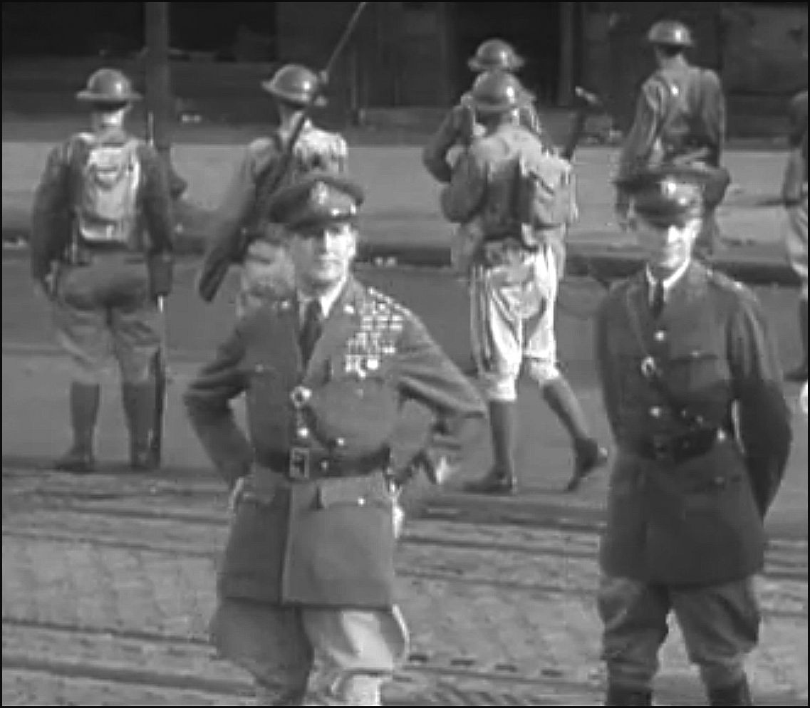
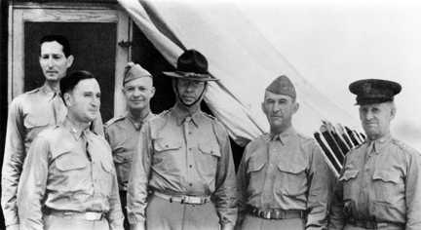
Assistant to Walter Krueger (next to the right)
Assistant to Douglas MacArthur

Slide 7
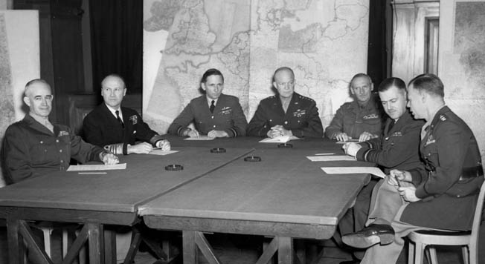
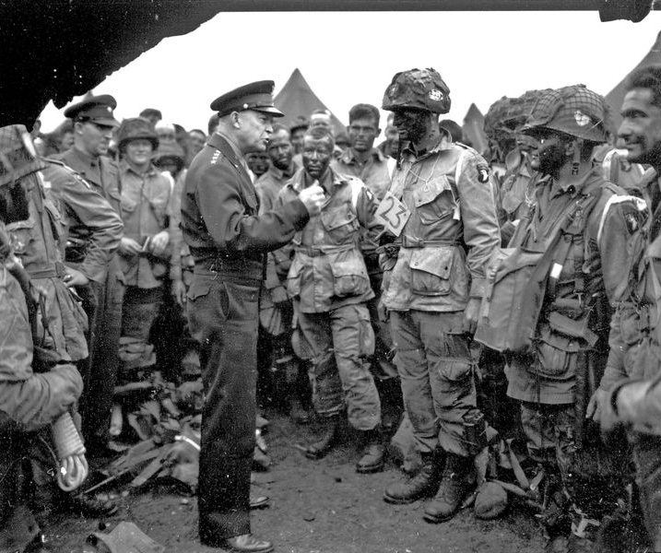
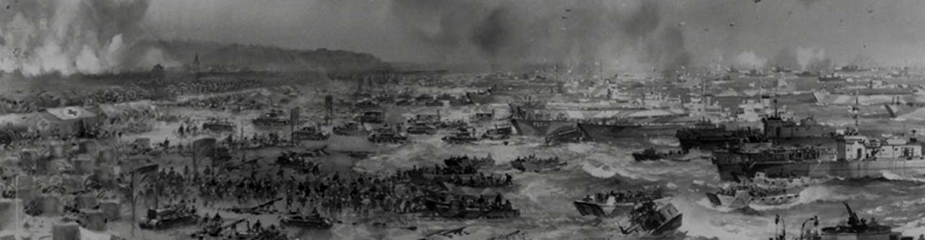

Slide 8
Paul’s Hallelujah Chorus: Gentiles, Praise God for What He Did for Jews
Ephesians 1:1-14
John H. Niemelä
May 20, 2019
At the GES National Conference, Plano, TX

Slide 9
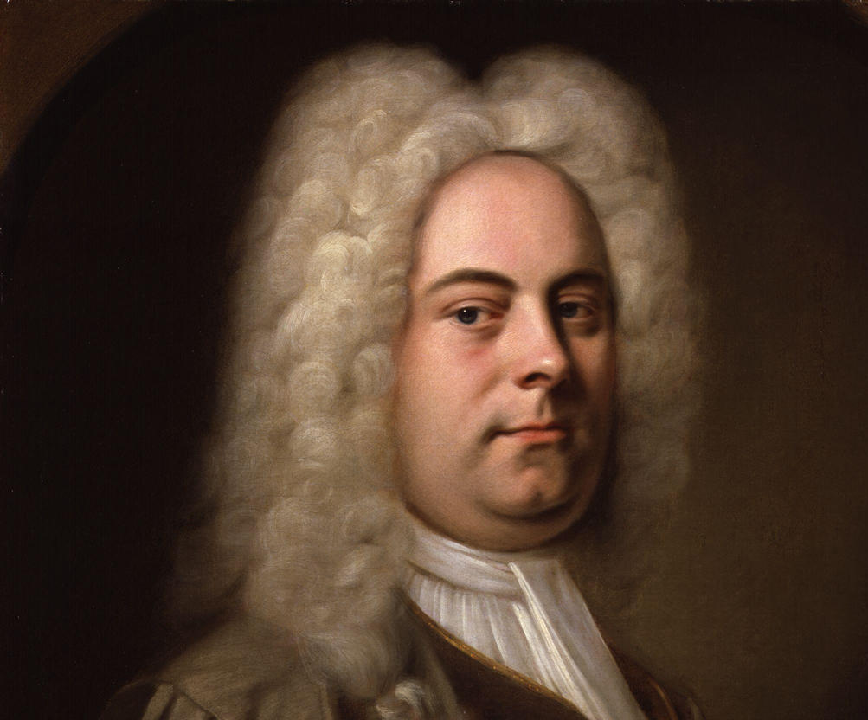
Outline of this passage
Prologue 1:1-2
The Hallelujah (Praise the Lord: the Father) Chorus 1:3-14
George Frideric Handel (1685–1759)

Slide 10
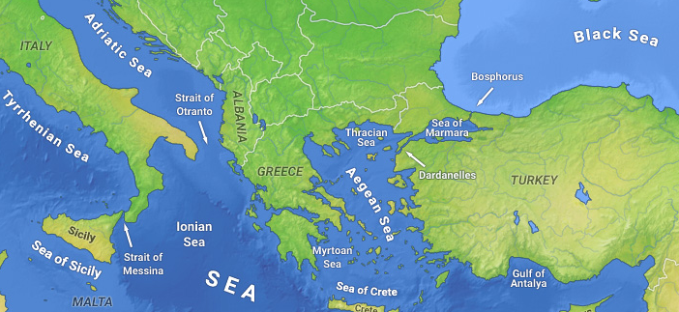
Prologue 1:1-2
ROME
Author: Paul
Place of writing: Rome
Date of writing: Winter 61-62
Destination: Ephesus
¹ Paul, an apostle of Jesus Christ by the will of God, To the saints who are in Ephesus, and faithful in Christ Jesus: ² Grace to you and peace from God our Father and the Lord Jesus Christ.
EPHESUS
1,250+ miles
COLOSSAE

Slide 11
Why Date Ephesians in Winter 61-62? (Part 1)
1. Paul’s First Roman imprisonment was February 60–March 62.
2. Philemon 22 says that Paul expected to be released soon.
3. Claudius decreed releasing untried prisoners after 18 months.
Philemon 22 suggests that book was written in late 61/early 62.
Was Ephesians written at the same time as Philemon?

Slide 12
Why Date Ephesians in Winter 61-62? (Part 2)
1. Tychicus carried Ephesians (Eph 6:21) & Colossians (Col 4:7).
2. Onesimus accompanied Tychicus to Colossae (Col 4:9).
3. Onesimus carried the letter of Philemon to Colossae (Philemon 12)
4. Rome to Ephesus is 1,250 miles. Ephesus to Colossae is 125 miles.
(about a 3-month journey) (a 1½-week journey)
The simplest view is that Tychicus and Onesimus made one trip together to both Ephesus and Colossae in late 61/early 62.

Slide 13
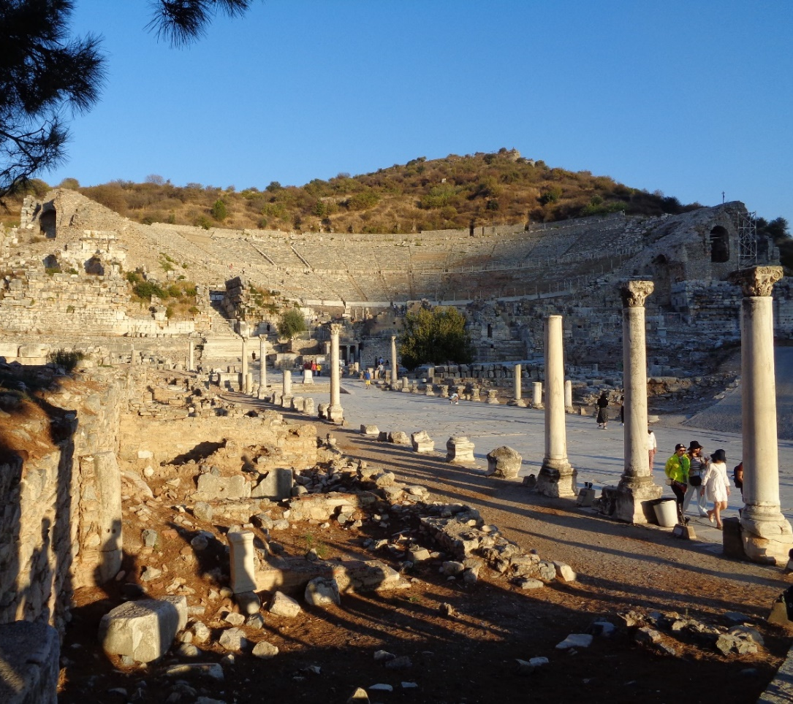
Paul’s Contacts with Ephesus
Ministry in a synagogue on 2nd journey.
Acts 18:19 (mid Sept 52)
Three years in Ephesus on 3rd journey,
until the riot at the main theater
Acts 19:1–20:1 (Sept 53–May 56)
Met Ephesian elders at Miletus (3rd journey)
Acts 20:16-38 (May 1-3, 57)
Wrote Ephesians (Late 61/Early 62)
The 25,000-seat theater in Ephesus,
Site of the riot against Paul.

Slide 14
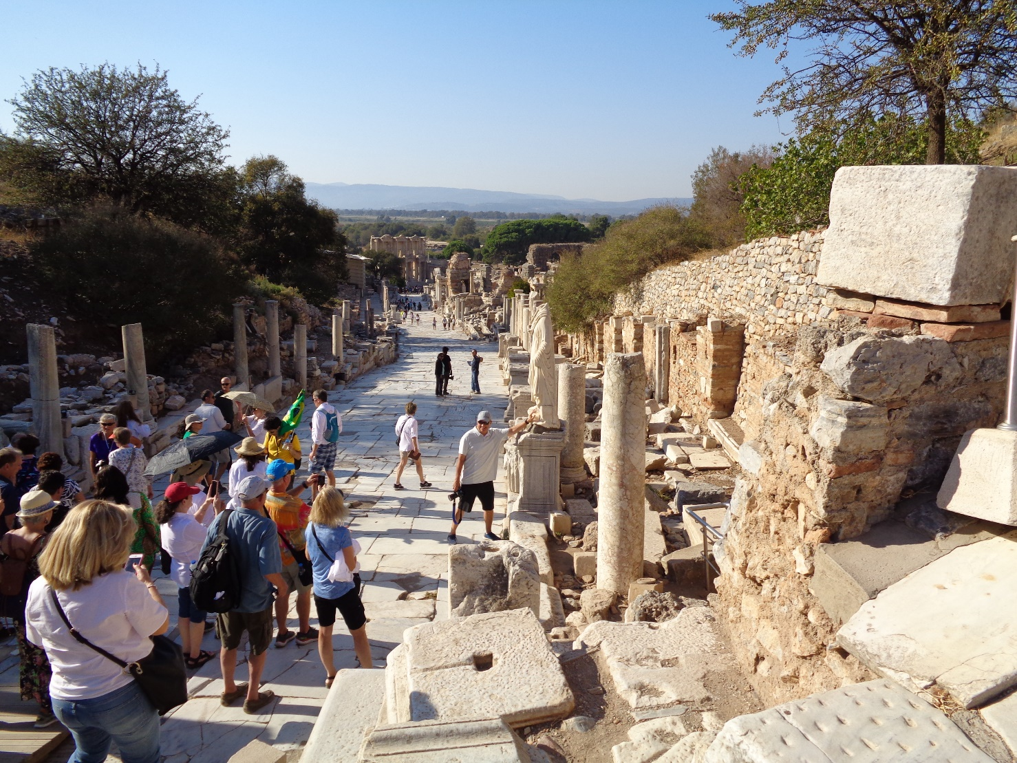
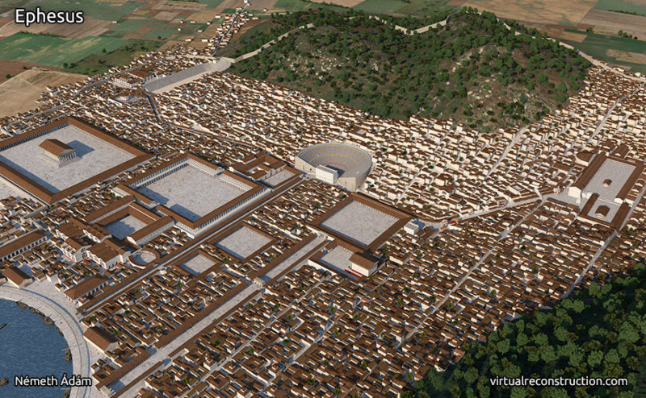
Why No “Greeting Section,” if Written to Ephesus?
Donald Guthrie notes that Paul reserves
personal greetings in his epistles for the
churches that he had never visited (see
Romans 16; Colossians 4; and Philemon.
Certainly, Tychicus (who carried the letter)
brought personal greetings from Paul.
Archaeologists estimate ancient Ephesus at 250,000 people.

Slide 15
Thematic Verses: Ephesians 4:1-6
4¹ I, therefore, the prisoner of the Lord, beseech you to walk worthy of the calling with which you were called, ² with all lowliness and gentleness, with longsuffering, bearing with one another in love, ³ endeavoring to keep the unity of the Spirit in the bond of peace.
Previews
Eph 4–6

Slide 16
Thematic Verses: Ephesians 4:1-6
Reviews
Eph 1–3
4⁴ [because] there is one body and one Spirit, just as you were called in one hope of your calling; ⁵ one Lord, one faith, one baptism; ⁶ one God and Father of all, who is above all, and through all, and in you all.

Slide 17
Thematic Verses: Ephesians 4:1-6
4¹ I, therefore, the prisoner of the Lord, beseech you to walk worthy of the calling with which you were called, ² with all lowliness and gentleness, with longsuffering, bearing with one another in love, ³ endeavoring to keep the unity of the Spirit in the bond of peace;
Reviews
Eph 1–3
4⁴ [because] there is one body and one Spirit, just as you were called in one hope of your calling; ⁵ one Lord, one faith, one baptism; ⁶ one God and Father of all, who is above all, and through all, and in you all.
Previews
Eph 4–6

Slide 18

The Theme of Ephesians
Let not man separate what God has joined together, (4:1-3) (4:4-6)
What God has joined together, let not man separate.
(Chapters 1–3) (Chapters 4–6)

Slide 19
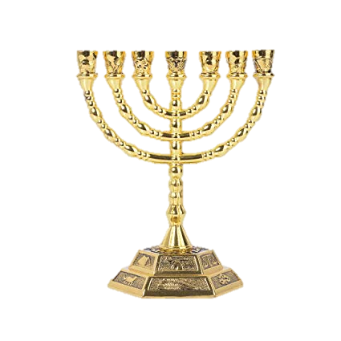
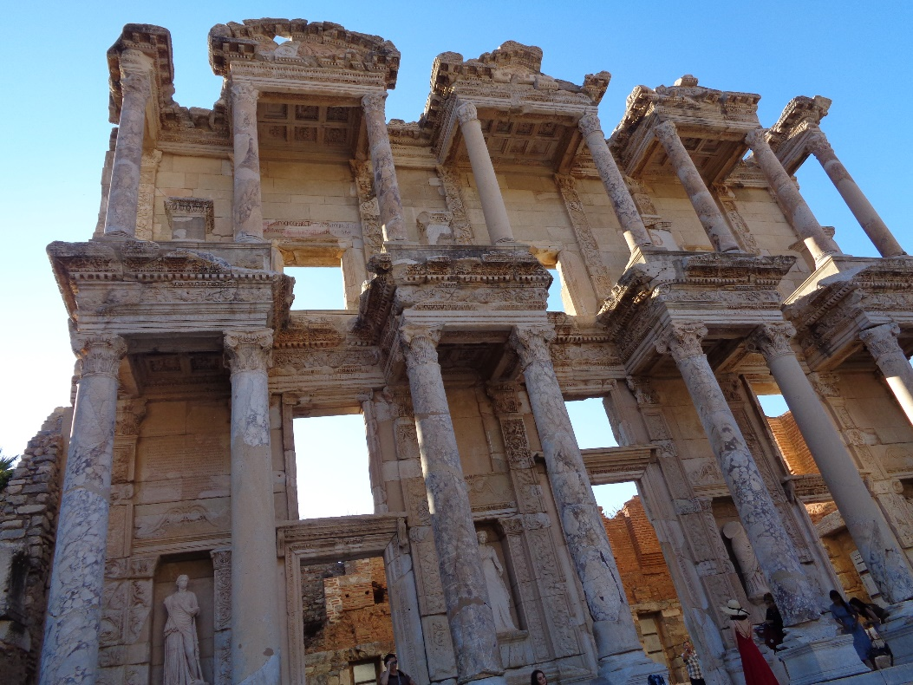
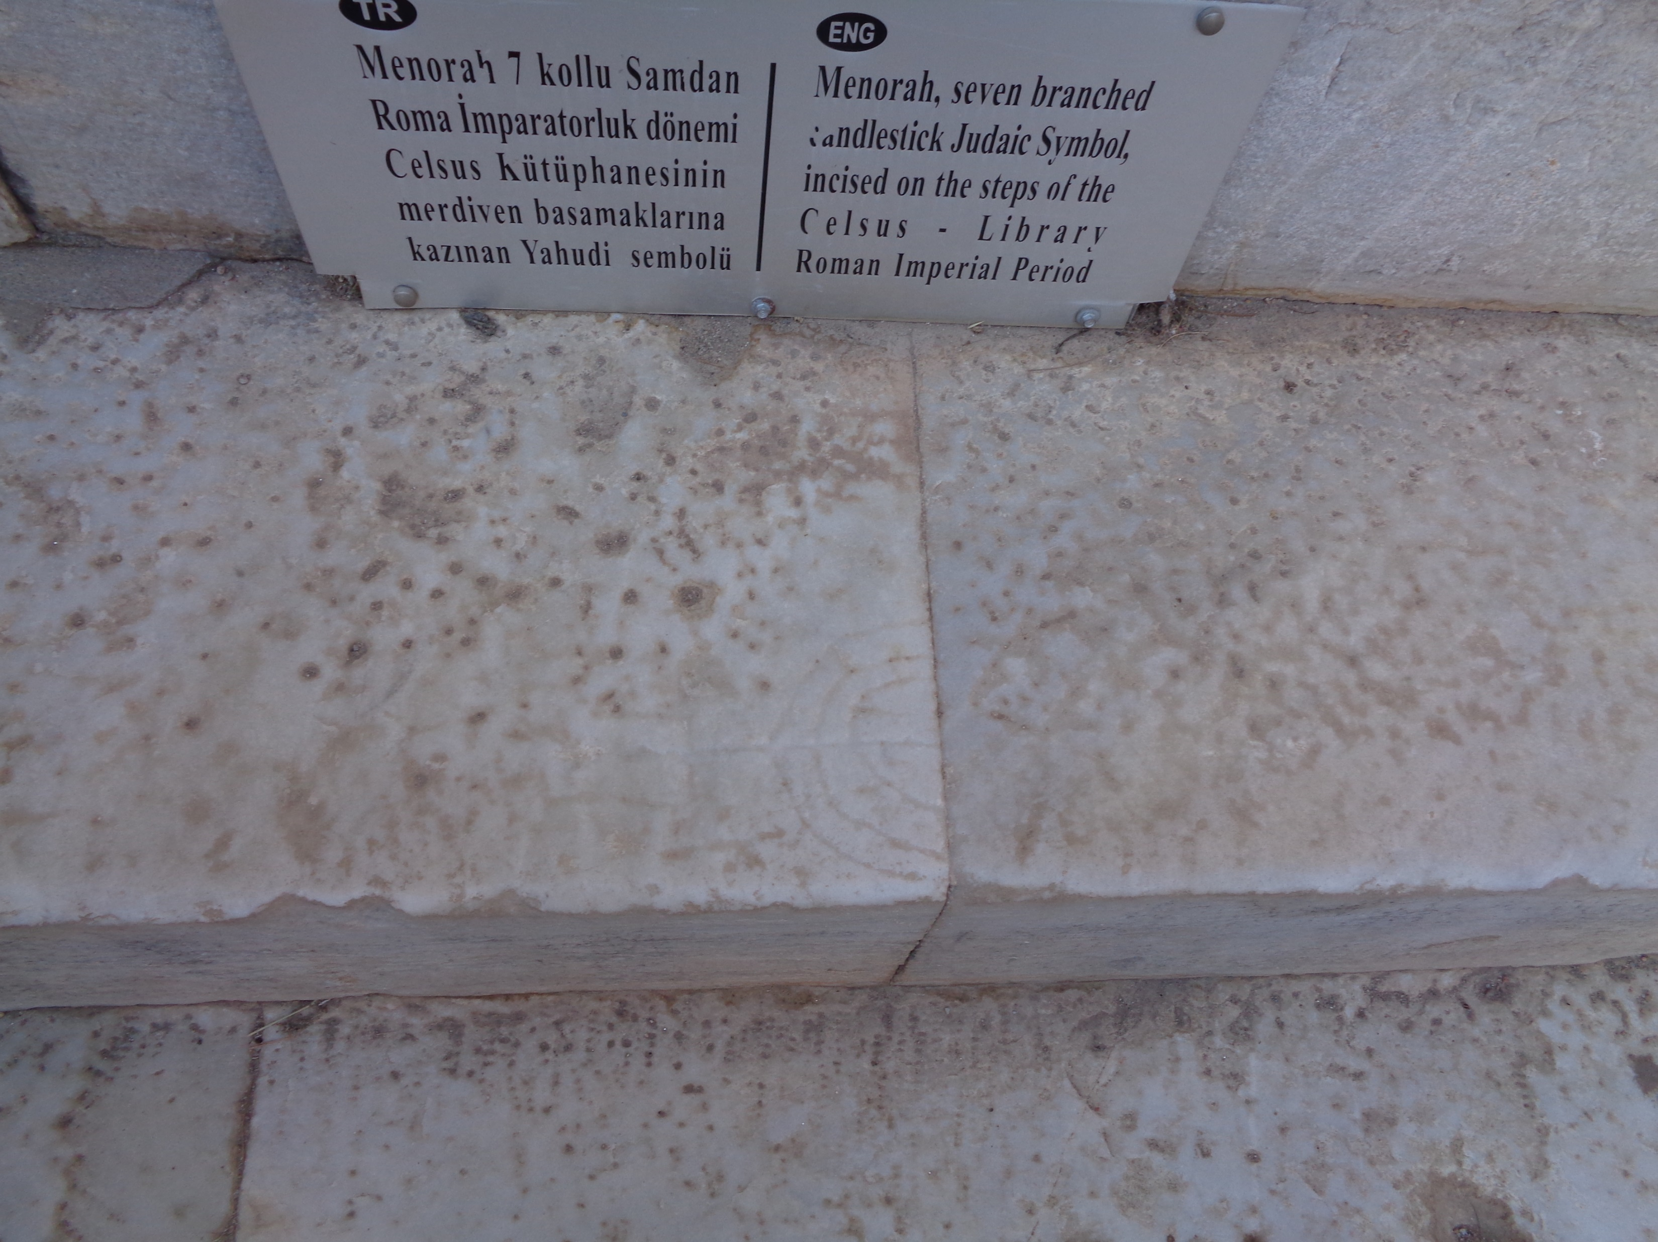
Disunity in Ephesus
Gentiles Jews
(The Library of Celsus)

Slide 20
Prologue 1:1-2
ROME
Author: Paul
Place of writing: Rome
Date of writing: Winter 61-62
Destination: Ephesus
¹ Paul, an apostle of Jesus Christ by the will of God, To the saints who are in Ephesus, and faithful in Christ Jesus: ² Grace to you and peace from God our Father and the Lord Jesus Christ.
EPHESUS
1,250+ miles
COLOSSAE

Slide 21
Outline of this passage
Prologue 1:1-2
The Hallelujah (Praise the Lord: the Father) Chorus 1:3-14
George Frideric Handel (1685–1759)

Slide 22
Paul’s Hallelujah Chorus (1:3-14)
Hallelujah (Praise the Father) Chorus 1:3 Chorus
The Father’s Praiseworthy Work 1:4-6 Stanza 1
The Son’s Praiseworthy Work 1:7-12 Stanza 2
The Spirit’s Praiseworthy Work 1:13-14 Stanza 3

Slide 23
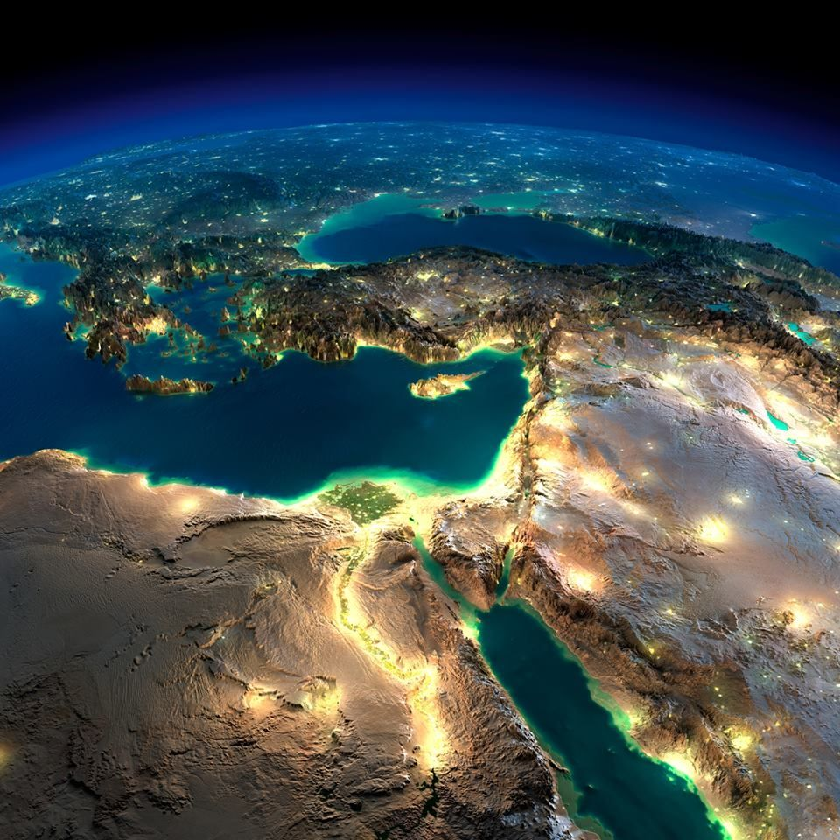
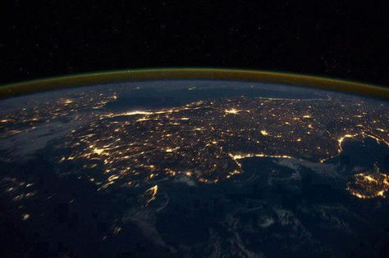
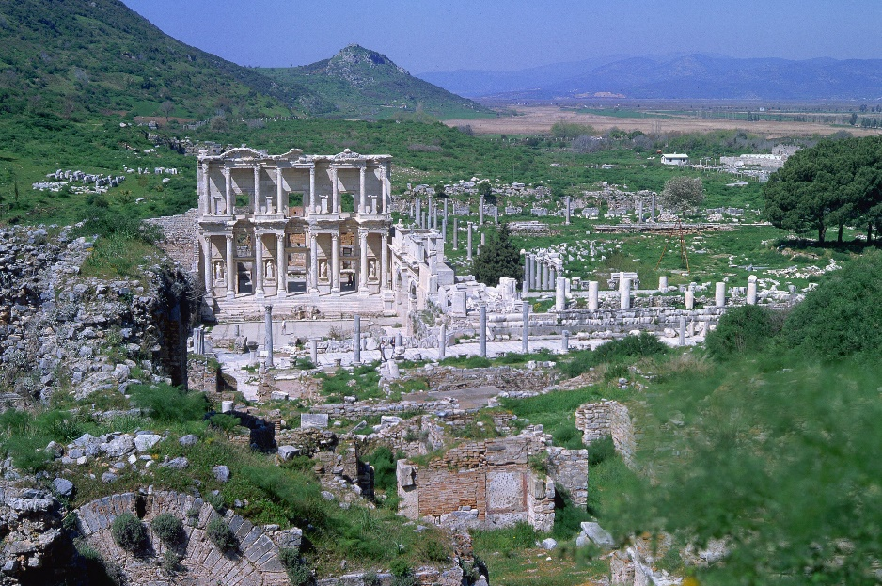
Ephesus from distant space…
…from earth orbit…
…from the sky.

Slide 24
Ephesus from Space (1:3-14)
Ephesus and the Mideast from space

Slide 25
Ephesus from Space (1:3-14)
Hallelujah (Praise the Father) Chorus 1:3 Chorus
The Father’s Praiseworthy Work 1:4-6 Stanza 1
The Son’s Praiseworthy Work 1:7-12 Stanza 2
The Spirit’s Praiseworthy Work 1:13-14 Stanza 3

Slide 26
C
S1
S2
S3
³ Blessed be the God and Father of our Lord Jesus Christ, who has blessed us with every spiritual blessing in the heavenly places in Christ,
⁴ just as He [THE FATHER] chose us in Him before the foundation of the world, that we should be holy and without blame before Him in love, ⁵ having predestined us to adoption as sons by Jesus Christ to Himself, according to the good pleasure of His will, ⁶ to the praise of the glory of His grace, by which He has made us accepted in the Beloved.
⁷ In Him [THE SON] we have redemption through His blood, the forgiveness of sins, according to the riches of His grace ⁸ which He made to abound toward us in all wisdom and prudence, ⁹ having made known to us the mystery of His will, according to His good pleasure which He purposed in Himself, ¹⁰ that in the dispensation of the fullness of the times He might gather together in one all things in Christ, both which are in heaven and which are on earth— in Him. ¹¹ In Him also we have obtained an inheritance, being predestined according to the purpose of Him who works all things according to the counsel of His will, ¹² that we who first trusted in Christ should be to the praise of His glory.
¹³ In Him you also trusted, after you heard the word of truth, the gospel of your salvation; in whom also, having believed, you were sealed with the Holy Spirit of promise, ¹⁴ who [THE HOLY SPIRIT] is the guarantee of our inheritance until the redemption of the purchased possession, to the praise of His glory.

Slide 27
C
S1
S2
S3
³ Blessed be the God and Father of our Lord Jesus Christ, who has blessed us with every spiritual blessing in the heavenly places in Christ,
⁴ just as He [THE FATHER] chose us in Him before the foundation of the world, that we should be holy and without blame before Him in love, ⁵ having predestined us to adoption as sons by Jesus Christ to Himself, according to the good pleasure of His will, ⁶ to the praise of the glory of His [the Father’s] grace [1:6], by which He has made us accepted…
⁷ In Him [THE SON] we have redemption through His blood, the forgiveness of sins, according to the riches of His grace ⁸ which He made to abound toward us in all wisdom and prudence, ⁹ having made known to us the mystery of His will, according to His good pleasure which He purposed in Himself, ¹⁰ that in the dispensation of the fullness of the times He might gather together in one all things in Christ, both which are in heaven and which are on earth— in Him. ¹¹ In Him also we have obtained an inheritance, being predestined according to the purpose of Him who works all things according to the counsel of His will, ¹² that we who first trusted in Christ should be to the praise of His [the Father’s] glory [1:12].
¹³ In Him you also trusted, after you heard the word of truth, the gospel of your salvation; in whom also, having believed, you were sealed with the Holy Spirit of promise, ¹⁴ who [THE HOLY SPIRIT] is the guarantee of our inheritance until the redemption of the purchased possession, to the praise of His [the Father’s] glory [1:14].

Slide 28
Ephesus from Space (1:3-14)
Hallelujah (Praise/bless the Father) Chorus 1:3
The Father’s Praiseworthy Work 1:4-6
to the praise of the glory…
The Son’s Praiseworthy Work 1:7-12
to the praise of His glory
The Spirit’s Praiseworthy Work 1:13-14
to the praise of His glory

Slide 29
Ephesus from Space (1:3-14)
How verse 3 relates to verses 4-6, 7-12, and 13-14
Chorus (1:3)
Stanza 1: First reason for blessing the Father (1:4-6)
Stanza 2 Second reason for blessing the Father (1:7-12)
Stanza 3 Third reason for blessing the Father (1:13-14)

Slide 30
Ephesus from Space (1:3-14)
Chorus (1:3) Bless the Father
Stanza 1 (1:4-6) for the Father’s praiseworthy work
Chorus (1:3) Bless the Father
Stanza 2 (1:7-12) for the Son’s praiseworthy work
Chorus (1:3) Bless the Father
Stanza 3 (1:13-14) for the Spirit’s praiseworthy work

Slide 31
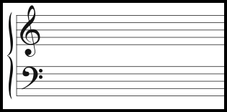
Ephesus from Space (1:3-14)
Chorus (1:3)
Stanza 1 (1:4-6)
Praise the Father
for the Father’s praiseworthy work
“to the praise of the glory of His grace” (1:6)

Slide 32
Ephesus from Space (1:3-14)
Chorus (1:3)
Stanza 2 (1:7-12)
Praise the Father
for the Son’s praiseworthy work
“to the praise of His glory” (1:12)

Slide 33
Ephesus from Space (1:3-14)
Chorus (1:3)
Stanza 3 (1:13-14)
Praise the Father
for the Spirit’s praiseworthy work
“to the praise of His glory” (1:14)

Slide 34
Ephesus from distant space…
…from earth orbit…
…from the sky.

Slide 35
Ephesus from earth orbit (1:3-14)
Ephesus and Turkey from space

Slide 36
Ephesus from earth orbit (1:3-14)
Bless the Father (1:3) for the FATHER PREPLANNING the inheritance* (1:4-6)
Bless the Father (1:3) for the SON PROCURING the inheritance (1:7-12)
Bless the Father (1:3) for the SPIRIT PROTECTING the inheritance (1:13-14)
*Inheritance is mentioned in stanzas 2-3, but implied in stanza 1.

Slide 37

Ephesus from earth orbit (1:3-14)
The Father preplanning the inheritance:
Choosing
preparing a destination: sonship adoption
Before the foundation
of the
world

Slide 38
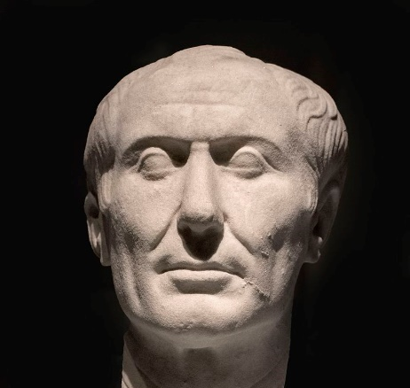
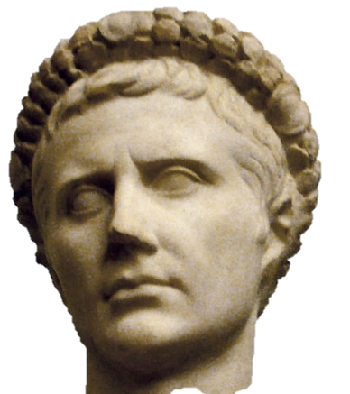
Ephesus from earth orbit (1:3-14)
The Father preplanning, the Son procuring, and the Spirit protecting THE INHERITANCE:
1:5: The Father preplanned a destiny for placement as sons (adoption)
1:11: In Christ, an inheritance is obtained, via the prepared destiny
1:14: The Spirit is the earnest money for the inheritance.
Julius Caesar Augustus Caesar
Via his (Roman) adoption by Julius Caesar, Augustus succeeded
Julius as Roman emperor. Adoption confers inheritance rights.

Slide 39

Ephesus from earth orbit (1:3-14)
The Son procuring the inheritance:
Redemption
Forgiveness
Made the mystery known
“We” obtained inheritance in Him via being
prepared for sonship adoption
(which carries inheritance rights)

Slide 40
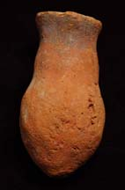
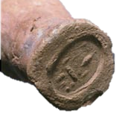
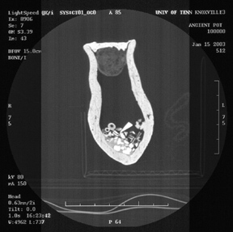
Ephesus from earth orbit (1:3-14)
The Spirit protecting the inheritance:
Sealing
Earnest (money) toward redemption
3½”
1½”

Slide 41
Ephesus from earth orbit (1:3-14)
Bless the Father (1:3) for the FATHER PREPLANNING the inheritance* (1:4-6)
Bless the Father (1:3) for the SON PROCURING the inheritance (1:7-12)
Bless the Father (1:3) for the SPIRIT PROTECTING the inheritance (1:13-14)
*adoption in 1:5 is about inheritance rights

Slide 42
Ephesus from distant space…
…from earth orbit…
…from the sky.

Slide 43
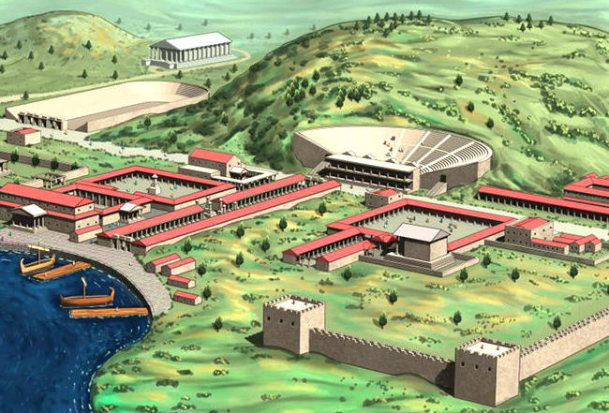
Ephesus from the air (1:3-14)

Slide 44
³Blessed be the God & Father of our Lord Jesus Christ, who has blessed us with every spiritual blessing in the heavenly places in Christ, ⁴just as He chose us in Him before the foundation of the world, that we should be holy and without blame before Him in love, ⁵having predestined us to adoption as sons by Jesus Christ to Himself, according to the good pleasure of His will, ⁶to the praise of the glory of His grace, by which He has made us accepted in the Beloved. ⁷In Him we have redemption through His blood, the forgiveness of sins, according to the riches of His grace ⁸which He made to abound toward us in all wisdom and prudence, ⁹having made known to us the mystery of His will, according to His good pleasure which He purposed in Himself, ¹⁰that in the dispensation of the fullness of the times He might gather together in one all things in Christ, both which are in heaven and which are on earth—in Him. ¹¹In Him also we have obtained an inheritance, being predestined according to the purpose of Him who works all things according to the counsel of His will, ¹²that we who first hoped in Christ should be to the praise of His glory. ¹³In Him you also hoped, when you heard the word of truth, the gospel of your salvation; in whom also, having believed, you were sealed with the Holy Spirit of promise, ¹⁴who is the guarantee of our inheritance until the redemption of the purchased possession, to the praise of His glory. (Eph 1:3-14)

Slide 45
³Blessed be the God & Father of our¹ Lord Jesus Christ, who has blessed us²with every spiritual blessing in the heavenly places in Christ, ⁴just as He chose us³ in Him before the foundation of the world, that we⁴ should be holy and without blame before Him in love, ⁵having predestined us⁵ to adoption as sons by Jesus Christ to Himself, according to the good pleasure of His will, ⁶to the praise of the glory of His grace, by which He has made us⁶accepted in the Beloved. ⁷In Him we⁷have redemption through His blood, the forgiveness of sins, according to the riches of His grace ⁸which He made to abound toward us⁸in all wisdom and prudence, ⁹having made known to us⁹he mystery of His will, according to His good pleasure which He purposed in Himself, ¹⁰that in the dispensatioTwelve uses of we, us, ouri in ten verses. gather together in one all things in Christ, b Four uses of you, your in one verse.r—in m. ¹¹In Him also we¹⁰ have obtained an inheritance, being predestined according to the purpose of Him who works all things according to the counsel of His will, ¹²that we¹¹ who first hoped in Christ should be to the praise of His glory. ¹³In Him you¹ also hoped, when you² heard the word of truth, the gospel of your³ salvation; in whom also, having believed, you⁴ere sealed with the Holy Spirit of promise, ¹⁴who is the guarantee of our¹² inheritance until the redemption of the purchased possession, to the praise of His glory. (Eph 1:3-14)

Slide 46
Who are you? Who are we?
You are Gentiles:
2:11, 13 Therefore remember that you, once Gentiles in the flesh…were far off
2:17 He…preached peace to you who were afar off and to those who were near
3:1 …I, Paul, the prisoner of Christ Jesus for you Gentiles.
4:17 …you should no longer walk as the rest of the Gentiles walk…
We are Jews:
1:12 that we who first hoped in Christ* should be to the praise of His glory.
*Eph 1:12 considers Acts 2–9, when the Church had only Jews and proselytes.
Church age Jews hoped in Christ before Gentiles did (Acts 10 and Cornelius).

Slide 47
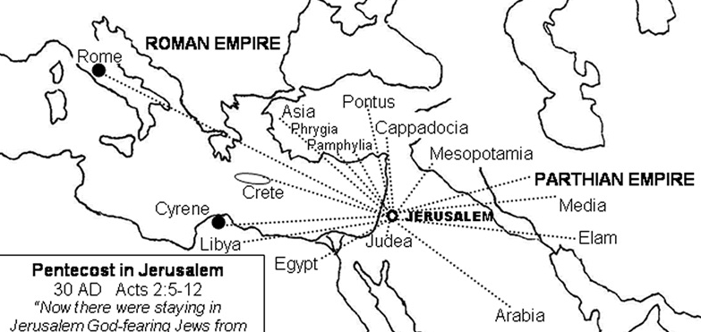
Who are “we who FIRST hoped in Christ”?
Jews and proselytes
(Acts 2:10)
Acts 2–9 Ever since Cornelius in Acts 10
Only Jews in the Church Jews and Gentiles in the Church

Slide 48
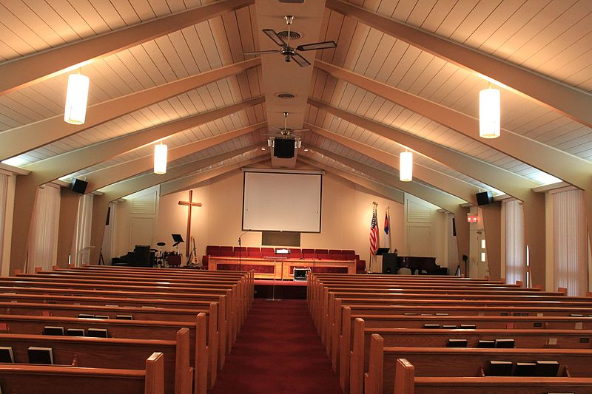
Who are you? Who are we?
Bride’s
Family
Groom’s
Family

Slide 49
Who are you? Who are we?
Bride’s
Family
Groom’s
Family
Couple’s Family

Slide 50
Who are you? Who are we?
You means Gentiles, whether believers or unbelievers (2:11; 3:1; 4:17).
We can mean:
Jewish unbelievers (2:5)
Jewish believers (1:3-9, 11-12, 14)
The body of Christ, whether Jewish or Gentile believers (2:14)
we you
we

Slide 51
Who are you? Who are we?
You are Gentiles:
2:11 Therefore remember that you, once Gentiles in the flesh…
3:1 …I, Paul, the prisoner of Christ Jesus for you Gentiles.
4:17 …you should no longer walk as the rest of the Gentiles walk…
We are Jews:
1:12 that we who first trusted in Christ should be to the praise of His glory.
Or we are the body of Christ (both Jews and Gentiles):
2:14 He Himself is our peace, who made both [Jews and Gentiles] one…

Slide 52
Disunity in Ephesus
Gentiles Jews
(The Library of Celsus)

Slide 53
Disunity in Ephesus
Gentiles Jews
(The Library of Celsus)

Slide 54
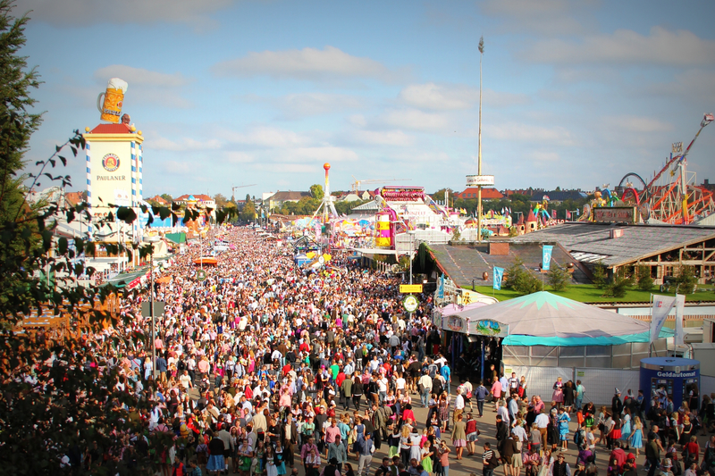
The One New Man Created from the Two Jews The New Man Gentiles

Slide 55
³Blessed be the God & Father of our¹ Lord Jesus Christ, who has blessed us²with every spiritual blessing in , ⁴just as He chose us³ in Him before the foundation of the world, that we⁴ should be holy and without blame before Him in love, ⁵having predestined us⁵ to adoption as sons by Jesus Christ to Himself, according to the good pleasure of His will, ⁶to the praise of the glory of His grace, by which He has made us⁶accepted in the Beloved. ⁷In Him we⁷have redemption through His blood, the forgiveness of sins, according to the riches of His grace ⁸which He made to abound toward us⁸in all wisdom and prudence, ⁹having made known to us⁹he mystery of His will, according to His good pleasure which He purposed in Himself, ¹⁰that in the dispensatioTwelve uses of we, us, ouri in ten verses. gather together in one all things in Christ, b Four uses of you, your in one verse.r—in m. ¹¹In Him also we¹⁰ have obtained an inheritance, being predestined according to the purpose of Him who works all things according to the counsel of His will, ¹²that we¹¹ who first hoped in Christ should be to the praise of His glory. ¹³In Him you¹ also hoped, when you² heard the word of truth, the gospel of your³ salvation; in whom also, having believed, you⁴ere sealed with the Holy Spirit of promise, ¹⁴who is the guarantee of our¹² inheritance until the redemption of the purchased possession, to the praise of His glory. (Eph 1:3-14)
EQUALITY?

Slide 56
³Blessed be the God & Father of Jews’¹ Lord Jsus Christ, whos blessed Jews²w every spiritual blessing in the heavenly places in Christ, ⁴just as He chose Jews³ in im before the foundation of the world, that Jews⁴ould be holy and without blame before Him in love, ⁵having predestined Jews⁵ to ation as sons by Jesus Christ to Himself, according to the good pleasure of His will, ⁶to the praise of the glory of His grace, by which He has made Jews⁶accepn the Beloved. ⁷In Him Jews⁷haveedemption through His blood, the forgiveness of sins, according to the riches of His grace ⁸which He made to abound toward Jews⁸inl wisdom and prudence, ⁹having made known to Jews⁹heystery of His will, according to His good pleasure which He purposed in Himself, ¹⁰that in the dispensatioTwelve references to Jewsi in ten verses. gather together in one all things in Christ, b Four references to Gentiles in one verse.r—in m. ¹¹In Him also Jews¹⁰have obtained an inheritance, being predestined according to the purpose of Him who works all things according to the counsel of His will, ¹²that Jews¹¹ wfirst hoped in Christ should be to the praise of His glory. ¹³In Him Gentiles¹ aloped, when Gentiles² hthe word of truth, the gospel of Gentiles’³ son; in whom also, having bved, Gentiles⁴ere with the Holy Spirit of promise, ¹⁴who is the guarantee of Jews’¹² inhtance until the redemption of the purchased possession, to the praise of His glory. (Eph 1:3-14)
EQUALITY?

Slide 57
Equality?
JEWS IN BODY
OF CHRIST
Sealed
GENTILES IN
Blessed spiritually Forgiven BODY OF CHRIST
Chosen for holiness Bountiful grace
Adopted sons Told the mystery
Accepted in the Beloved Obtained an inheritance
Redeemed Have HS as earnest

Slide 58
Paul’s Hallelujah Chorus: Gentiles, Praise God for What He Did for Jews
Ephesians 1:1-14

Slide 59
How the Emphasis on Jews (1:3-14) fits with EQUALITY
Paul says “to the Jew FIRST and also to the Greek” in Romans 1:16; 2:9-10
City 1 City 2 City Z
A. To Jews A. To Jews A. To Jews
B. Rejection B. Rejection B. Rejection
C. To Gentiles C. To Gentiles C. To Gentiles
D. Next city D. Next city D. Next city

Slide 60
EXPLAINING CHOOSING IN EPHESIANS 1:4
God first chose for the body of Christ to include Jewish people (Acts 2–9)
God chose us (Jewish people) first
Next, God chose for the body of Christ to include Gentiles (Acts 10)
[Implicitly, then God chose you Gentiles]

Slide 61

EXPLAINING CHOOSING IN EPHESIANS 1:4
Offense Defense

Slide 62
How the Emphasis on Jews (1:3-14) fits with EQUALITY
Jews and Gentiles are equal in the body of Christ.
Gentiles should thank the Father for what the Trinity did for the Jews first [and for Gentiles afterwards].
What God has joined together let not man separate.

Slide 63
Conclusion 1
Bless the Father (1:3)
for His praiseworthy preplanning of the inheritance for Jewish members of the body of Christ first [but also for Gentiles] (1:4-6)*
*It only mentions Jews, but Gentiles have equal access to God.

Slide 64
Conclusion 2
Bless the Father (1:3)
for the Son’s praiseworthy procuring of the inheritance for Jewish members of the body of Christ first [but also for Gentiles] (1:7-12)*
*It only mentions Jews, but Gentiles have equal access to God.

Slide 65
Conclusion 3
Bless the Father (1:3)
for the Spirit’s praiseworthy protection of the inheritance for the body of Christ (1:13-14)*
*This passage mentions both Jews and Gentiles.

Slide 66
Penrose Stairs Do Not Apply
Start

Slide 67
Recap
Bless the Father because: (1:3)
the Father preplanned the inheritance for Jews in the body of Christ first for His praise (1:4-6)
the Son procured the inheritance of Jews in the body of Christ first for the Father’s praise (1:7-12)
the Spirit protects the inheritance of the body of Christ for the Father’s praise (1:13-14)

Slide 68
My View of Paul’s Use of Choosing in 1:4
We must be distinct from you here, since we hoped first.
You always means Gentiles in Eph; we always includes Jews.
Eph 1:3-14 has a corporate focus, but does not introduce the joining of Jews and Gentiles until 2:5-6.
The corporate focus here is of: (1) Jews and (2) Gentiles.
The corporate focus starting in ch 2 is of the body of Christ.

